Slide 1





Introduction to BlockChain Data
Company: Anyblock Analytics
Chaitanya Vallabhaneni

Slide 2



1.
BlockChain Data
Explaining what blockchain is
Other variables to consider

Slide 3

What is BlockChain Data?
Strings of Numbers and Letters
Withholds classified information
Runs and Protects Online Currency
Often Associated with BitCoin: a cryptocurrency coin
We will work two different cryptocurrencies: Ethereum and xDAI

Slide 4
2.
Examining BlockChain Data
Methods to analyze blockchain data

Slide 5
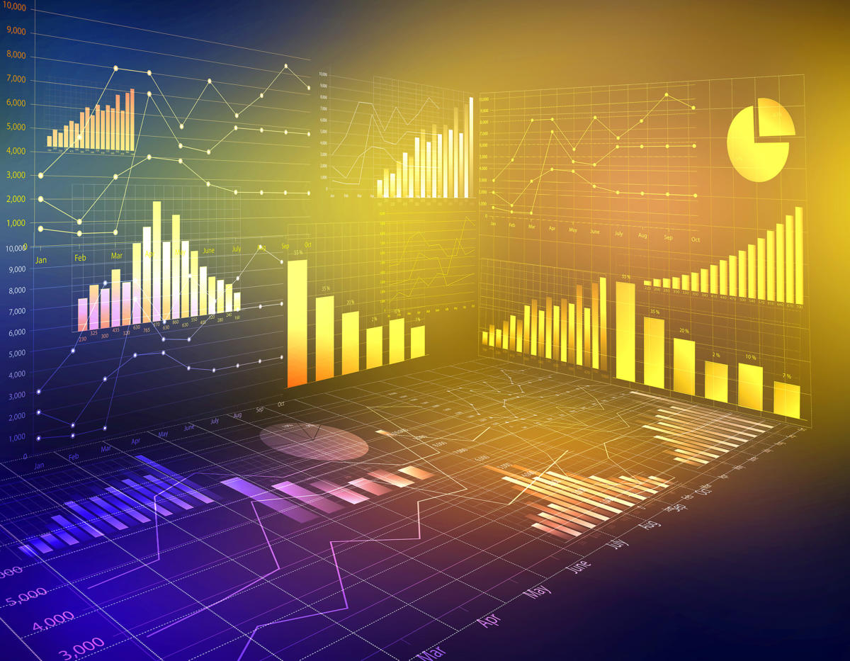
How to Examine BlockChain Data
Query Data with ElasticSearch API or SQL Access
Use different Blockchain Data Servers
Decode the Data or Perform Exploratory Data Analysis (EDA)

Slide 6
3.
Tokens
The significance of a Token
How it runs blockchain

Slide 7

The Significance of Tokens
Data that runs the Digital Currency
Each token has a value = net worth
Digital Money not actual money

Slide 8
4. Identifying
a Token
How an token looks like
How to tell the significance of each token

Slide 9
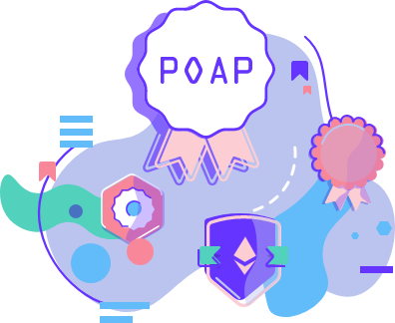
An Example of a Token
POAP (Proof of Attendance of Protocol) (1)
0x22C1f6050E56d2876009903609a2cC3fEf83B415
POAP tokens are free! It’s an open source community initiative
For our demonstrations the token above was used
Don’t be overwhelmed by its many letters and numbers
It is meant to be decoded and find metrics

Slide 10
5. Metrics
Token Facts
Token Statistics

Slide 11
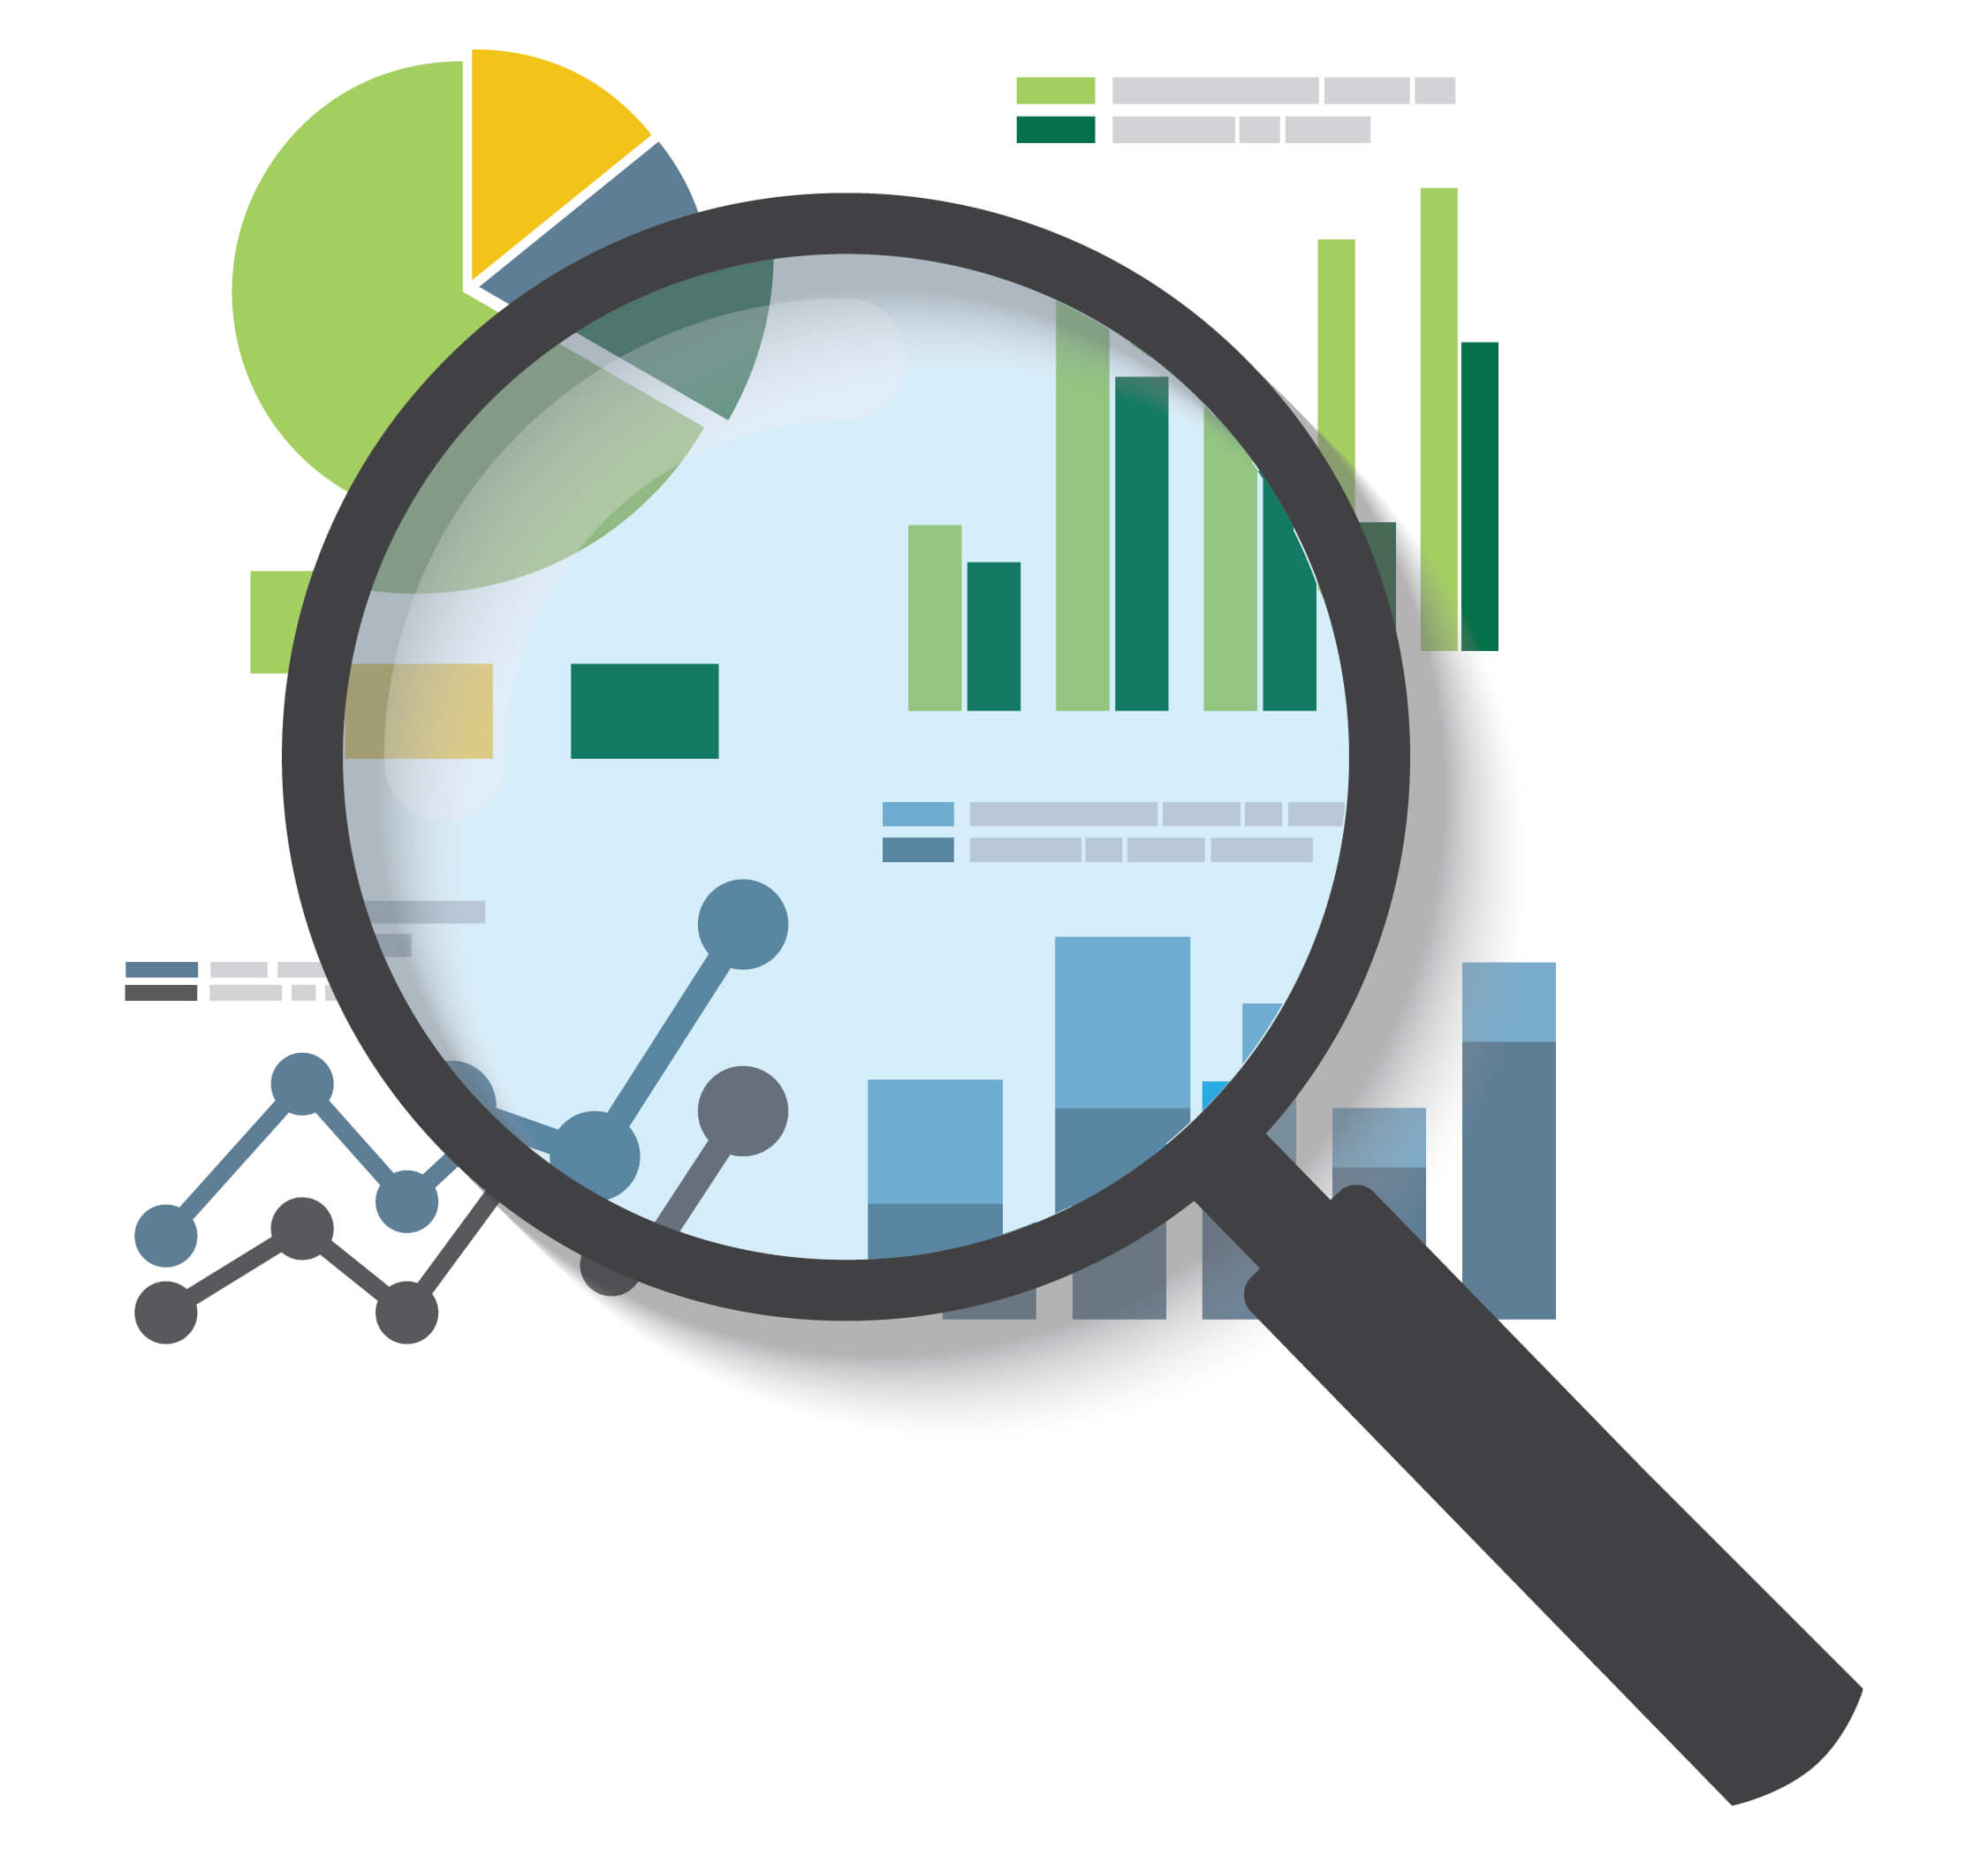
Token Metrics
Facts about tokens
Common metrics:
Token from which account
Token transfers per day
Token transfers monthly
Token transfers yearly
Token net worth, highest and lowest usd value

Slide 12
6. Websites to Retrieve Data
Anyblock Analytics Dashboards
Etherscan

Slide 13
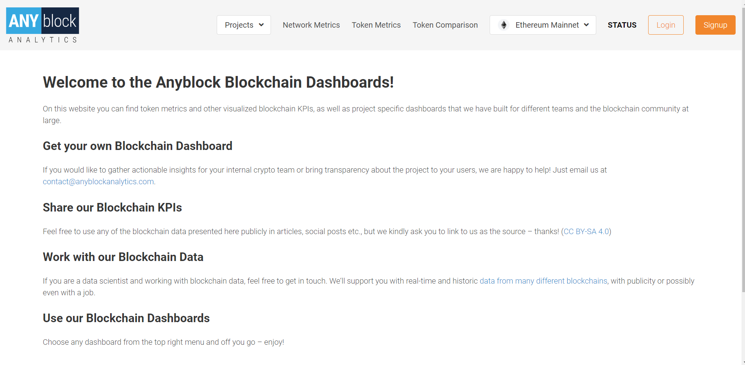
Resource 1: Anyblock Dashboards
Welcome to the Anyblock Blockchain Dashboards! (2)
Go to Token Metrics

Slide 14
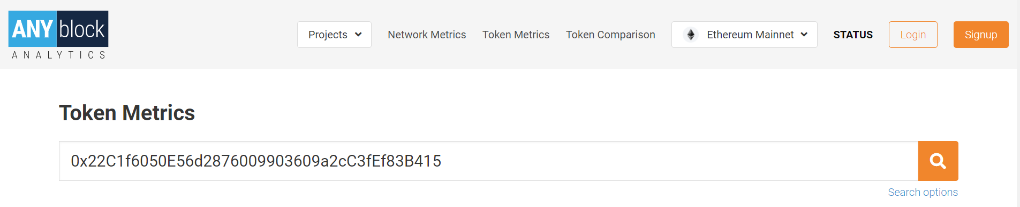
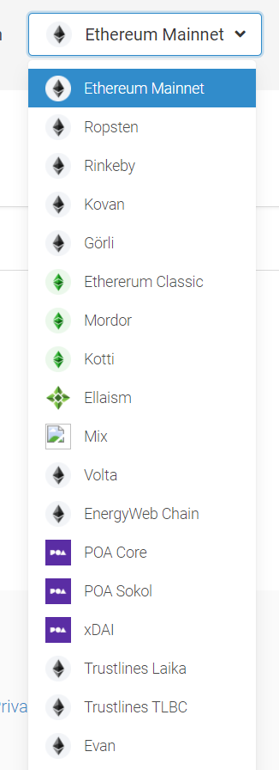
Resource 1: Customizing Options
Token Metrics (anyblock.tools)
Input the token in the search box
Token entered must be in accordance with its blockchain
Blockchain box - “Ethereum Mainnet”
Can change it to several blockchains

Slide 15
7. Anyblock Server Results
Blockchain Dash Board Results

Slide 16
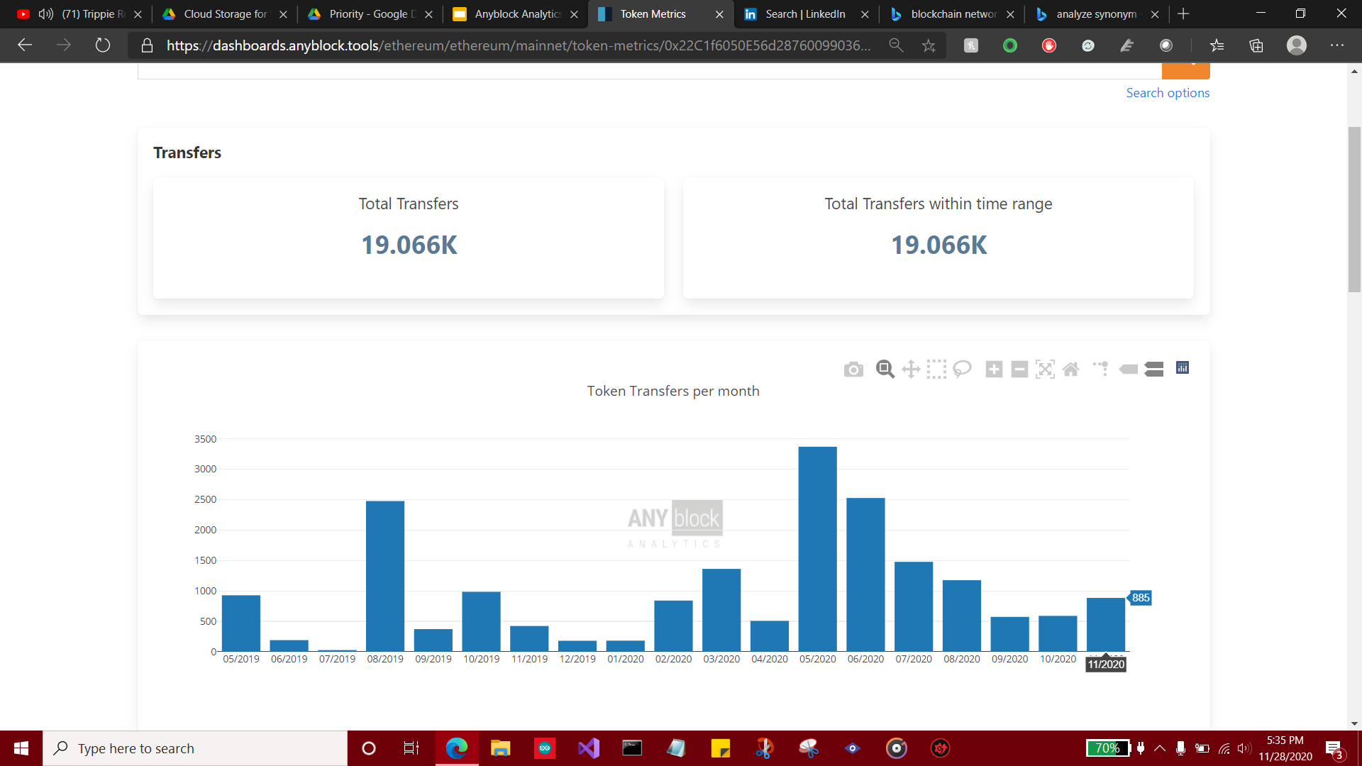
Day 1: 5:35 PM, 11/28/20
The token shows the total of transactions
A bar graph shows the spread of token transfers per month
More tokens is transferred overtime
A gradual change is seen normally per day

Slide 17
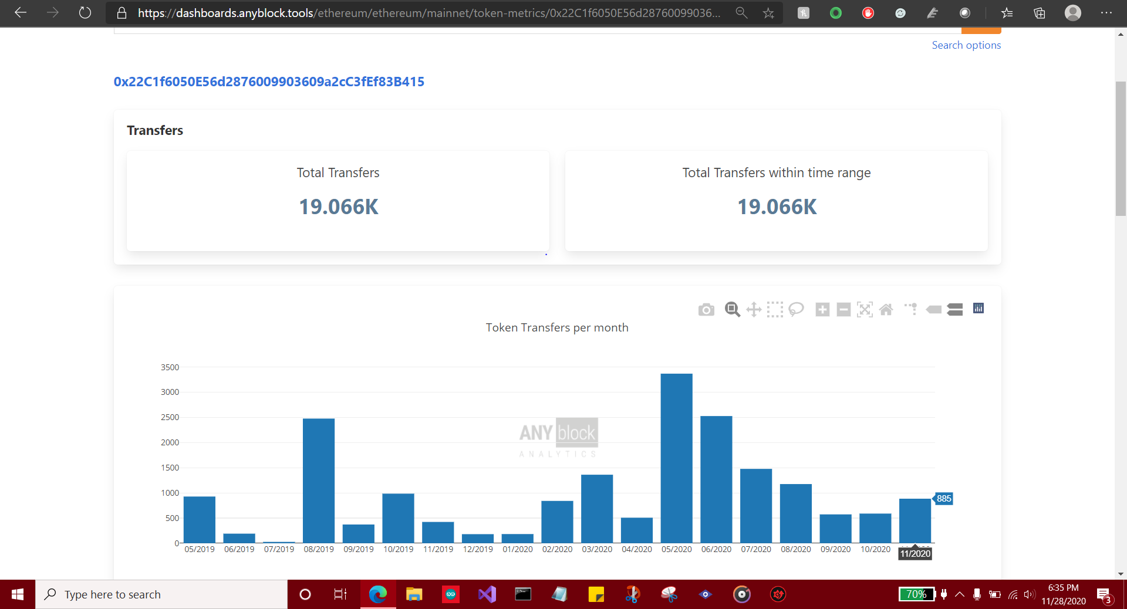
Day 1: 6:35 PM, 11/28/20
An hour has passed and total token remain the same
Expect changes in a few hours

Slide 18
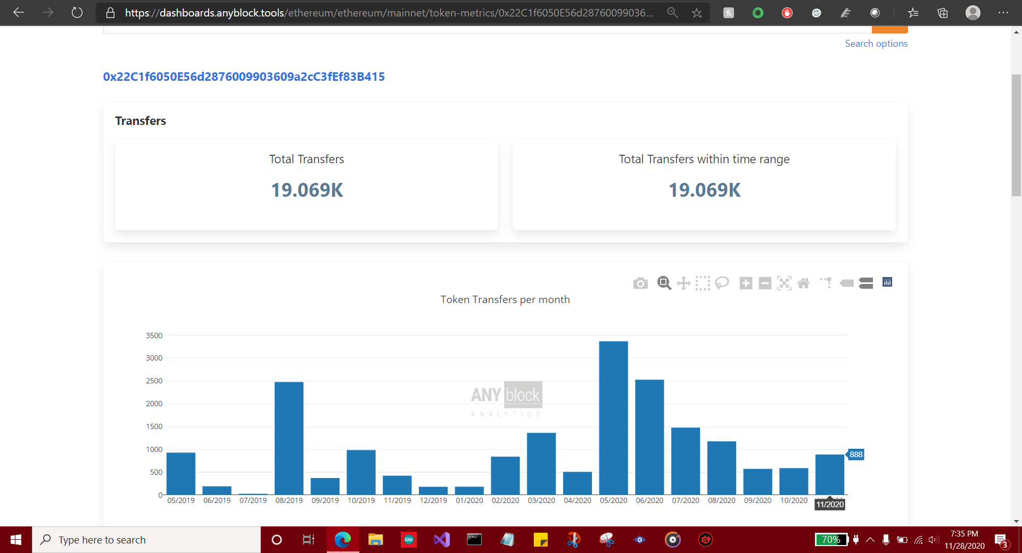
Day 1: 7:35 PM, 11/28/20
Another hour has passed
Total transactions increased by 3

Slide 19
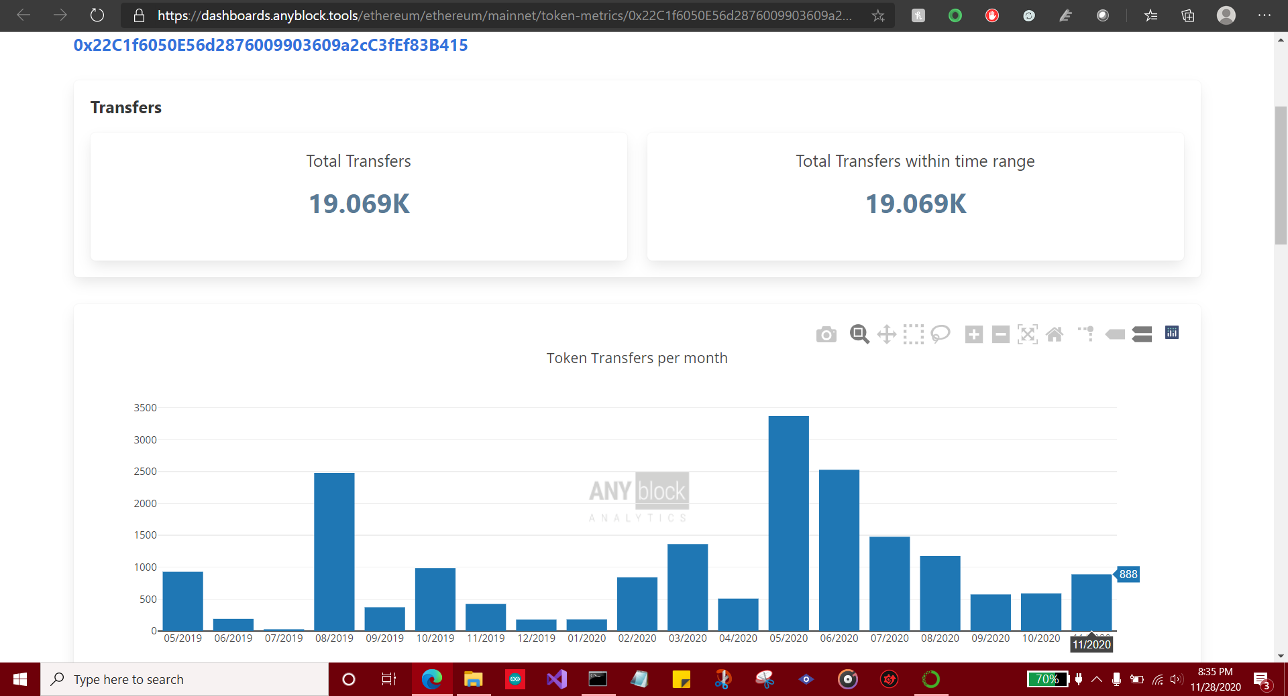
Day 1: 8:35 PM, 11/28/20
Another hour passed
Transactions remained the same

Slide 20
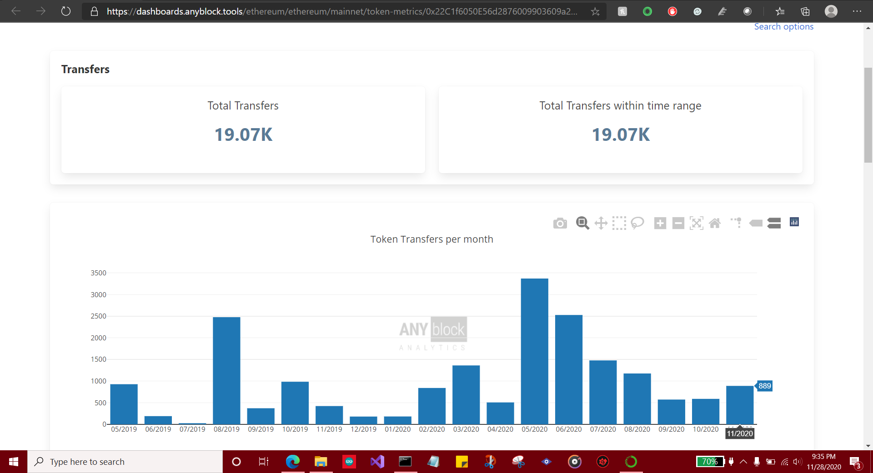
Day 1: 9:35 PM, 11/28/20
Another hour has passed
One more transaction
To observe a gradual change, it is best to check every 24 hours
Not an active poap token

Slide 21

Day 2: 5:35 PM, 11/29/20
Since one day has passed, there will be more transactions
Transactions increased from 19,070 to 19,084

Slide 22
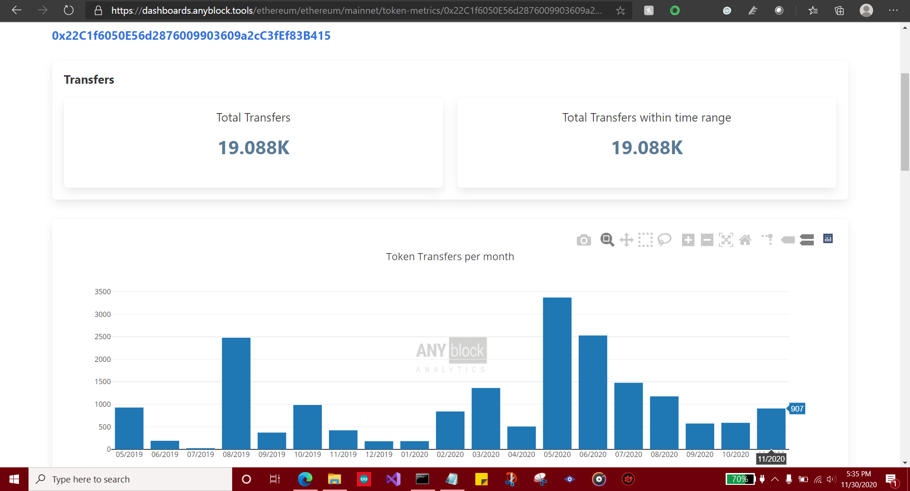
Day 3: 5:35 PM, 11/30/20
Since one day has passed, there will be more transactions
Transactions increased from 19,084 to 19,088

Slide 23
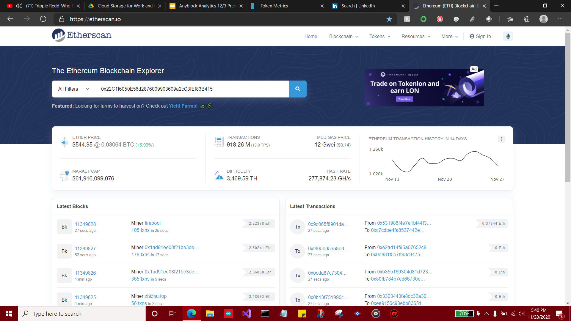
Resource 2: Etherscan
Ethereum (ETH) Blockchain Explorer (etherscan.io) (3)
Input the token into the search box

Slide 24
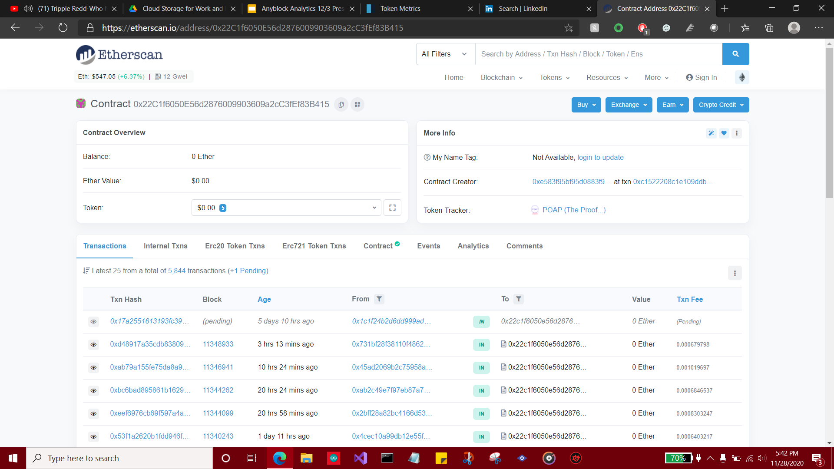
Etherscan Statistics
Gives Balance, Ether Value, and Token Net Worth
By default shows transactions
Transactions show how many unique tokens there are

Slide 25
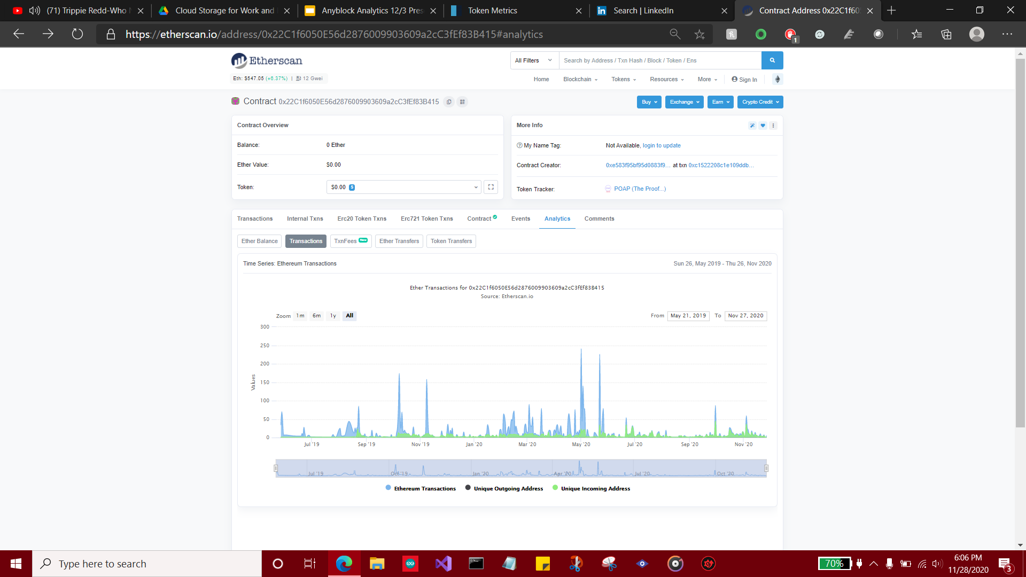
Etherscan: Analytics -> Transactions
The graph shows every POAP token transaction
From its starting date to present

Slide 26
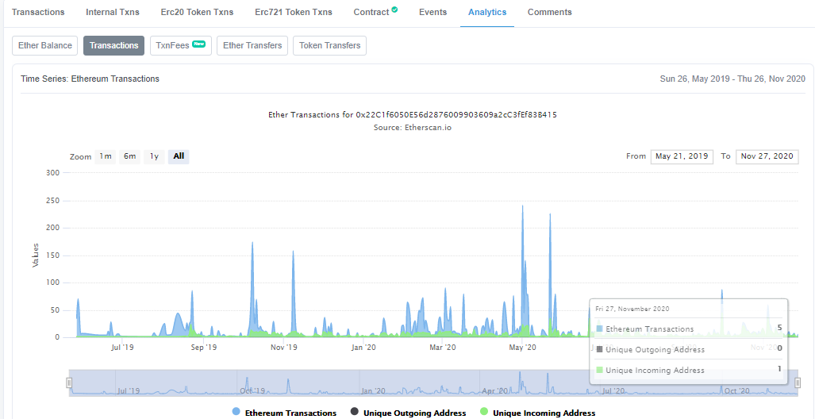
Etherscan Transaction Graph
Zoomed in view of the Ethereum Transaction Graph
Touch the graph to see a day’s ethereum transactions
Shows:
Ethereum Transactions
Unique Outgoing Address
Unique Incoming Address

Slide 27
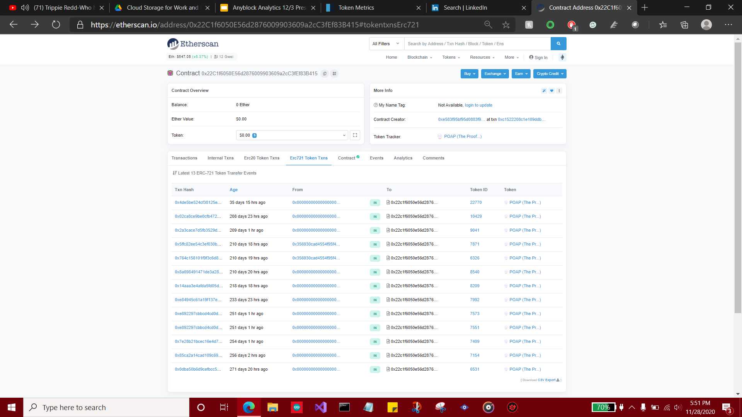
Etherscan Statistics: Erc721 Token Txns
Shows which transactions are POAP tokens

Slide 28
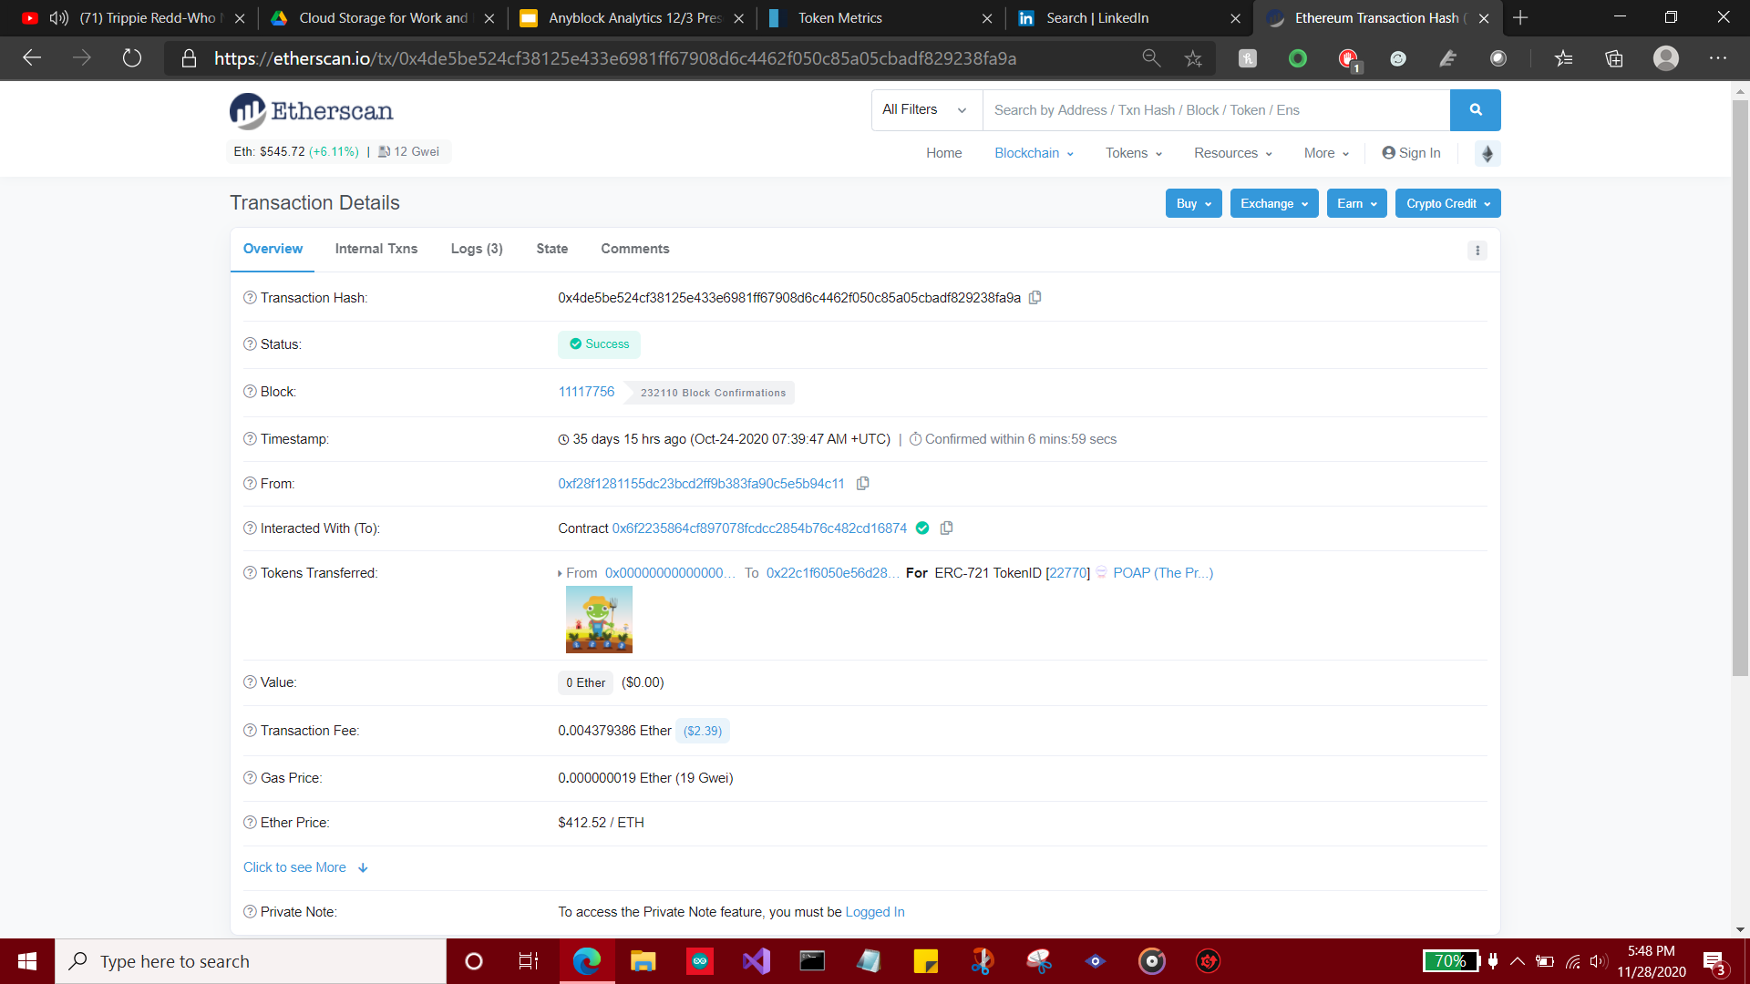
Clicking on a Particular Token:
Gives Balance, Ether Value, and Token Net Worth
Transactions show how many tokens are in the POAP token

Slide 29
8. Additional Data
Using Python to Further Analyze Token Data

Slide 30
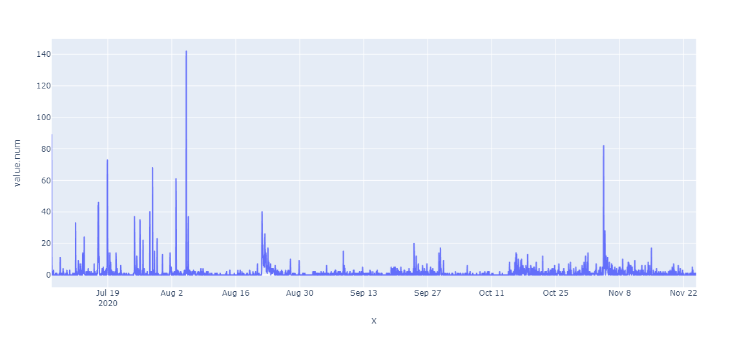
Number of POAP Transactions ‘20
Notes:
There was a spike in transactions between July 6th and August 6th as there was an event called ETHGlobal Hack FS. The purpose of the event was to build the foundation for the decentralized web. A virtual hackathon by ETHGlobal and Protocol labs.
Spike of transactions between 6th and 7th November: TruffleCon is a virtual community gathering for Truffle users, fans, developers, and those who want to build world-changing applications powered by decentralized technologies.

Slide 31
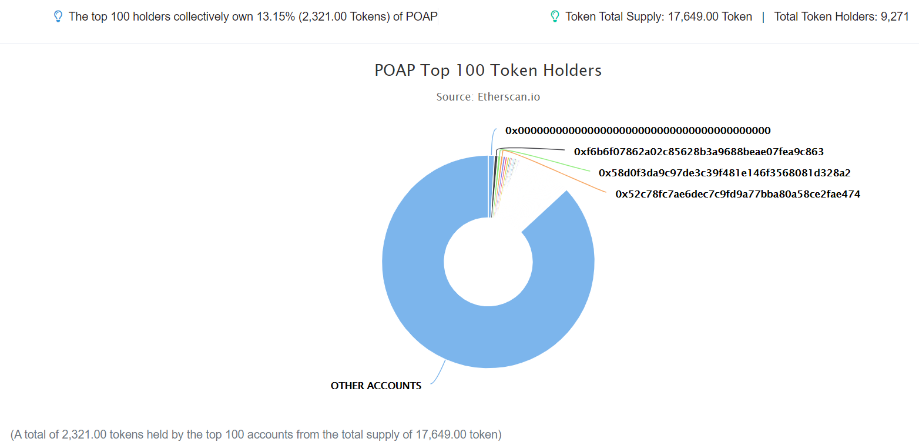
POAP Token Holdings

Slide 32
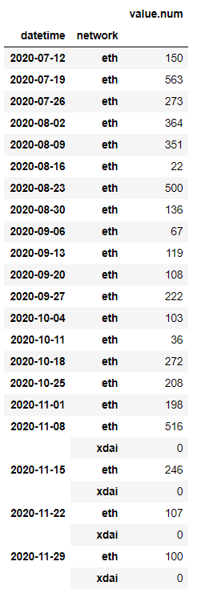
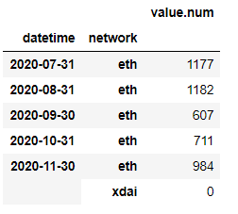
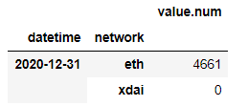
Token Transaction History

Slide 33
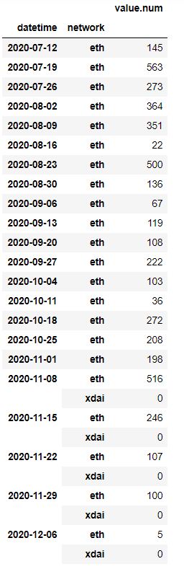
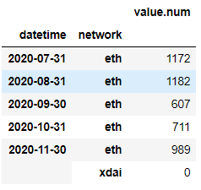
Token Transaction History: New Month, Week

Slide 34
9. Metric Findings
What the interns learned at Anyblock Analytics

Slide 35
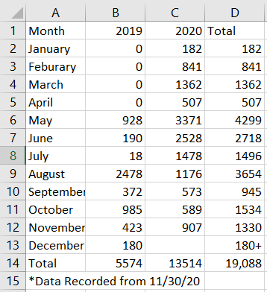
Metric Discoveries
Token History: May 2019 - Present (Recorded 11/30/2020, 5:35 PM)
Transactions:
Token Weekly
Token Monthly
Tokens Yearly
2019: 5574
2020: 13,514
Total: 19,088

Slide 36
10. Learning Experiences
What the interns learned at Anyblock Analytics

Slide 37
Learned what blockchain data is
Learned what a token is
Characteristics and variables related to a token
Token ID
Transaction Hash
Token Address
Cryptocurrencies
Different Types of Tokens
Querying Data
Using different blockchain networks: Ethereum and xDAI
Learned on how to use Elasticsearch API to query the blockchain data.
Explored the data using Pandas and Numpy libraries
Used Plotly Express, Matplotlib and Seaborn for data visualization

Slide 38
11. Sources
Websites

Slide 39
Sources
POAP - Homepage (1)
Welcome to the Anyblock Blockchain Dashboards! (2)
Ethereum (ETH) Blockchain Explorer (etherscan.io) (3)

Slide 40
12. Honorable Mentions
Giving Special Thanks

Slide 41
Honorable Mentions
On behalf from the three of us, we wanted to give thanks to:
CFO Friedrich “Freddy” Zwanzger
Data Scientist Yarkin Gocmen
Anyblock Analytics Team
i_XPERIENCE and Career Semester

Slide 42
THANK YOU!

